Slide 1
ACADEMY OF LEARNING
FOR LIFE
USE PAGE UP-PAGE DOWN or SCROLL TO ADVANCE SLIDES
Program Overview

Slide 2
The “ALL” Charter.
The Academy of Learning for life provides a continuing education module adapted to the needs of physical and mentally challenged students.
The program is designed to enhance the life skills of each student to his/her best ability and is based on curriculum similar to what you would expect in a normal school environment
Our goal is to provide a formal learning platform supported with a highly structured academic agenda.

Slide 3


Course Structure
Core Module
Extended Module
Recreation Module
READING: Classes are grouped by student ability. Subject matter is based on classic stories with focus on who, what, where, why and how.

Slide 4

Course Structure
.
LANGUAGE ARTS: This class is based on the biographies of historical people and the environment of their era. The students then create art activities related to what they have learned.
Core Module
Extended Module
Recreation Module

Slide 5
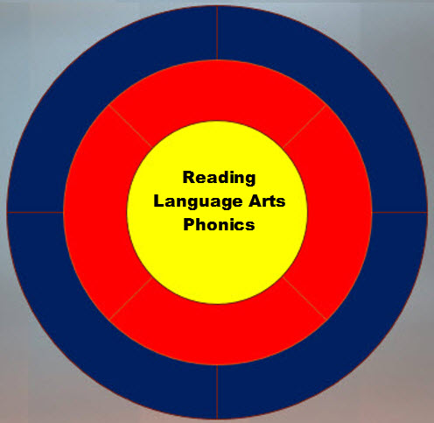
Course Structure
Core Module
Extended Module
Recreation Module
PHONICS: This class focuses on vocabulary development through the study of sounds, vowels, consonants, blends and word recognition.

Slide 6
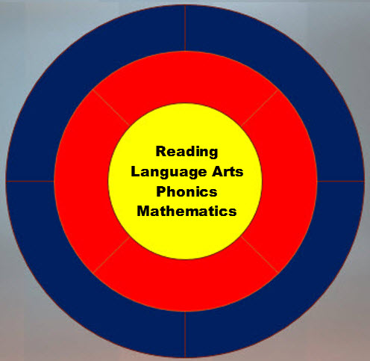
Course Structure
MATHEMATICS: The Students work on multiplication facts, division, money, story problems and algebra. Next semester this course will be extended to include measurements, geometry, banking and fractions.
Number games are also used to teach addition and subtraction without the use of a calculator.
Core Module
Extended Module
Recreation Module

Slide 7
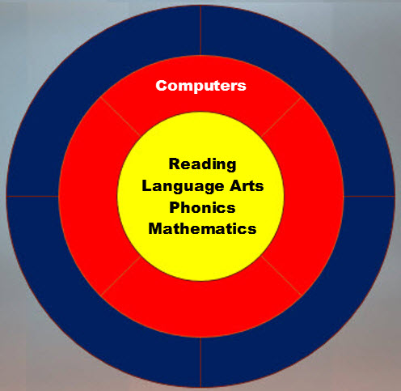
Course Structure
COMPUTERS: On lesson days this lab teaches students how to power the computer on and off, learning the function of the screen icons and keyboard. Running programs such as PowerPoint to make presentations and others producible items
On alternate days, interactive games are used to improve eye/hand coordination with the mouse and keyboard. Games include Book Worm, Mahjong, bowling, puzzles and the use of clip art.
Core Module
Extended Module
Recreation Module

Slide 8
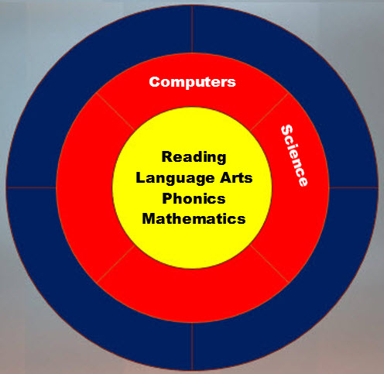
Course Structure
.
SCIENCE: Covers a wide range of subjects from animals (retiles, mammals, amphibians, fish and birds), DNA, weather phenomena, sound waves, to the area of physics in building bridges and other unique structures.
Core Module
Extended Module
Recreation Module

Slide 9
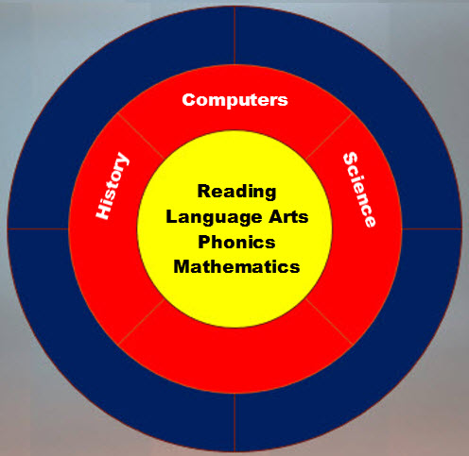
Course Structure
Core Module
Extended Module
Recreation Module
HISTORY: This is the study of life and times dating from the medieval era to the 20th century throughout Europe and the US.
Often the students will make costumes and other items that reflect a particular era. They are also tasked to identify relevant places on a world map.

Slide 10
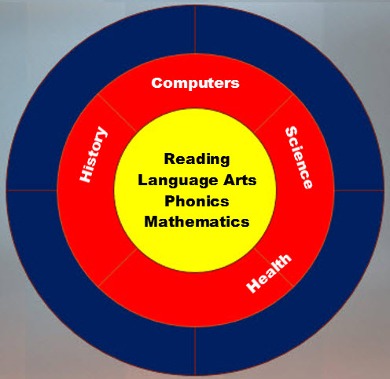
Course Structure
Core Module
Extended Module
Recreation Module
HEALTH: Students are taught to practice good eating habits in choosing meals and snacks.
They also learn simple exercises that they can do at home

Slide 11
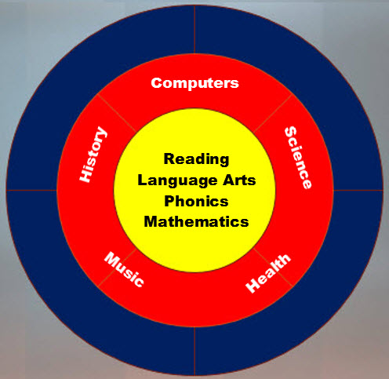
Course Structure
MUSIC THERAPY: This is provided by volunteer students from the TWU music therapy class in Denton. We have been very lucky to have a continuance of talented singers and musicians that have chosen this as their career path. Students participate both in singing and playing instruments.
This class brings out the happy faces of all the students !
Core Module
Extended Module
Recreation Module

Slide 12
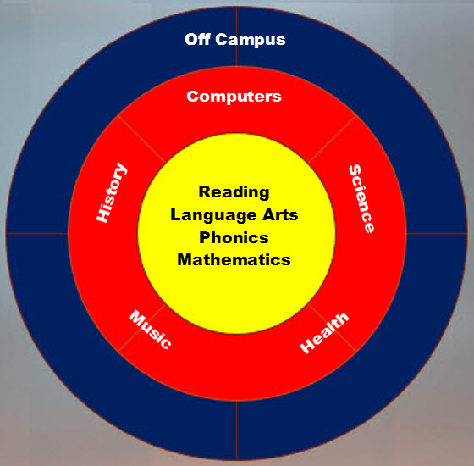
Course Structure
Core Module
Extended Module
Recreation Module
OFF CAMPUS: There are two annual scheduled activities.
The spring dinner and dance at the Grand Traditions hall in Corinth
At the end of each semester including the summer classes have a bowling outing.

Slide 13
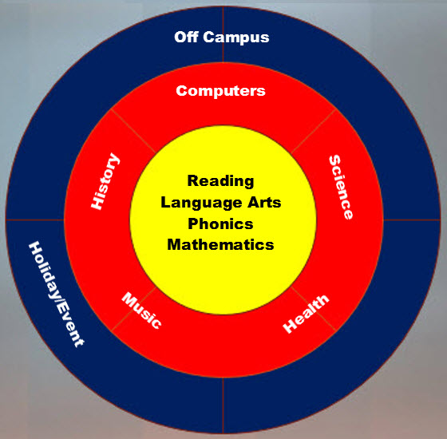
Course Structure
HOLIDAYS & EVENTS: Those that fall during school sessions are celebrated by the students and teachers.
Holiday customs throughout the world are discussed and if possible, art projects will be done about the customs.
Encouragement to accept all customs is greatly stressed.
Core Module
Extended Module
Recreation Module

Slide 14
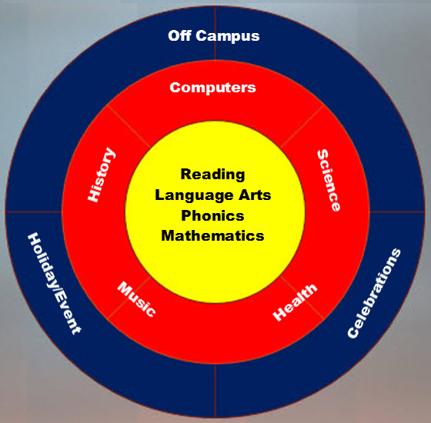
Course Structure
CELEBRATIONS: Birthdays are honored with a monthly party for those with birthdays in a particular month. This is inclusive of a decorative cake for the occasion.
Personal achievements such as participating in Special Olympics and other organizations are highlighted in the Academy’s website as well as the Facebook page.
Core Module
Extended Module
Recreation/Events

Slide 15
Classroom Environment
Classroom Staffing
  Each classroom has a teacher who presents the course material and paces the session to the ability of the students. Each teacher has an assistant who works individually with the students needing help to maintain a balanced momentum with all class members. All staff members have degrees in education, science and associate experience with physical and mentally challenged individuals
Classroom Facilities
  There are four main classrooms used for training and two smaller rooms used for “one on one” tutoring. The larger classroom has a high quality projection and sound equipped theater for audio visual presentation and movies. Adjacent to the classrooms is a large auditorium with a raised sound stage. This is used for the music therapy program and for student directed plays and events. There are restroom facilities for male /female students and teacher use.
Volunteer Services
  We have retired educators and other professionals that volunteer their time for “one on one” tutoring to students needing special help with reading, speech and other needs.

Slide 16
Classroom Training Material
Standard Educational Material
  Text books
  Work Books
  Work Sheets
  Videos
Specialized Educational Material
  Project Materials
  Hands-on Materials (Used in Math, Science and Phonics)

Slide 17
Contact and other information
Contact: Cheryl Yaeger
      2412 Waterbend Drive
      Flower Mound, TX 75028
        Telephone: 214-762-9013
Class Visitations: ALL has an open door policy for anyone that
would like to tour the facilities, visit the classrooms or meet with staff members.
Class hours are from 9:00 AM until noon on Monday through Thursday during school days.
More Information: Classroom video “snippets” have been posted on this website and can be accessed from the site navigator button above.

Slide 18
Bottom up Course Structure
Core Curriculum Module
Extended Curriculum Module
Recreational Activities

